Slide 1
Covid-19 Test Registration Guide
Please scan the QR code on your registration card with your phone camera and open the link to start the registration process.
Step 1
Register a coronavirus test (lateral flow test)
To complete this form, you’ll need:
The barcode for the test you’re registering (it starts with the letter ‘L’).
A mobile number (for you or the person you’re registering.
Step 2
Who are you registering a test for?
Complete accordingly
Step 3
Please register without creating an account
Step 4
Enter the unique test kit barcode
Step 5
What’s the test site’s ID or name?
Scan my barcode
TPAL
Test kit barcode reference or URN
Confirm test kit barcode reference or URN
Step 6
Confirm your test site
Test Site ID – TPAL
The Priory Academy LSST
Cross O’Cliff Hill
Lincoln
LN5 8PW
Tick – I went to this test site
Step 7
Are you doing 7-day repeat testing?
If you’re in contact of someone who tested positive for Covid 19, your organisation may have invited you to take a test every day for 7 days instead of self-isolating. If so, you can select ‘YES’
If ‘yes’ please inform the registration assistant
Step 8
When will you take the coronavirus test?
Tick – TODAY
Select Time
Step 9,10 & 11
Complete
Name
Date of birth
Gender
Step 12 & 13
Complete
What is your ethnic group?
Answer accordingly

Slide 2
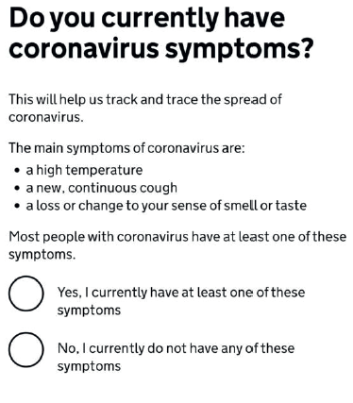
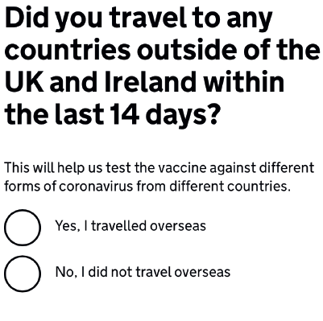
Step 14
Do you travel to nursery, work or a place of education?
Tick – Yes, I go to nursery, school, college or university
Step 15
Choose your place of education?
Click – secondary school
Step 16
Name of secondary school?
The Priory Academy LSST
Step 17
Step 18
Step 19
Have you had a coronavirus vaccine?
Tick – No
Unless, of course, you have had the vaccine.
Step 20
What country do you live in?
Answer accordingly
Step 21
What is the first line of your address & home postcode?
Complete accordingly
Step 22
Do you have an email address?
Complete accordingly
Step 23
What is your mobile number?
Complete
&
confirm

Slide 3
Step 24
Do you have a landline number?
Complete
accordingly
Step 25
Do you know your NHS number?
Complete accordingly
Summary of answers
Please check carefully that all your answers are correct before confirming.
You are now ready for your test
Please
proceed
to the
Test Centre
If the QR reader does not work please use the following registration webpage:
www.test-for-coronavirus.service.gov.uk/register-kit

