Slide 2
Human Life Span
A1. Physical development
Birth to infancy 0-2 years-old

Slide 3
Lifespan stages
Predict the age ranges and features for each of these life stages below before
Looking at the answers on the next slide.
Life stage | Age Group | Key Features
Birth to infancy
Early Childhood
Adolescence
Early Adulthood
Middle Adulthood
Later Adulthood

Slide 4
Lifespan stages
If you internet search, there are a range of different life stages but for the purpose of exam testing, you will be learning, the below….
Life stage | Age Group | Key Features
Birth to infancy | 0-2 years | Infant rapid growth, approx half of adult height, by the time they’re two. At around one years, walking starts, by two, they start to run. Teeth start at about 3 months.
Early Childhood | 3-8 years | Children continue to grow at a steady pace, developing strength and co-ordination.
Adolescence | 9-18 years | Experience growth spurts and develop sexual characteristics during puberty.
Early Adulthood | 19-45 years | Young adults reach the peak of their physical fitness
Middle Adulthood | 46-65 years | The aging process begins with some loss of strength and stamina, women go through menopause.
Later Adulthood | 65 years onwards | Aging continues with gradual loss of mobility, older adults experience height loss; a few centimetres

Slide 5
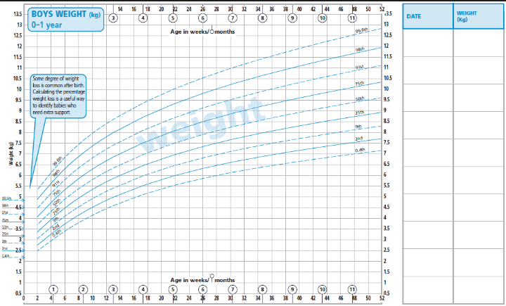
Centile line explained….. If a child's weight is at the 50th percentile line, that means that out of 100 normal children her age, 50 will be bigger than she is and 50 smaller. Similarly, if she is in the 75th percentile, that means that she is bigger than 75 children and smaller than only 25, compared with 100 children her age.

Slide 6
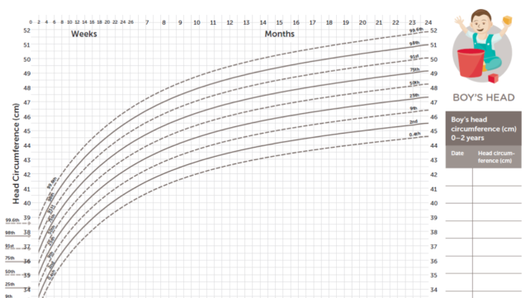
A percentile (or a centile) is a measure used in statistics indicating the value below which a given percentage of observations in a group of observations fall. The higher the percentile number, the bigger your baby is compared to other babies her same age. If your baby is in the 50th percentile for length, that means he/she falls right in the middle of the pack

Slide 7
A growth chart is used by paediatricians and other health care providers to follow a child's growth over time. Growth charts have been constructed by observing the growth of large numbers of normal children over time.

Slide 8
Head proportion in growth

Slide 9
Health Visitors role
The child will have an allocated health visitor that is attached to their GP. They will hold baby clinics for weighing and measuring at the surgery and also carry out timed home visits, recording in the red book.

Slide 10
Primitive & postural reflexes
Primitive reflexes are reflex actions originating in the central nervous system that are exhibited by normal infants, but not adults, in response to particular stimuli. The birth process is a key factor in the integration of these reflexes. Therefore a traumatic birth experience or birth by c-section may lead to retained reflexes longer than norm.
Postural Reflexes are automatic movements that control the equilibration we require once upright and moving and having to combat the effects of gravity. They maintain posture, balance and fluidity of movement, replacing the Primitive Reflexes in a sequential manner, as those Primitive Reflexes inhibit.

Slide 11
Permanent and primitive reflexes
https://www.khanacademy.org/test-prep/mcat/behavior/human-development/v/physical-development-in-adolescence

Slide 12
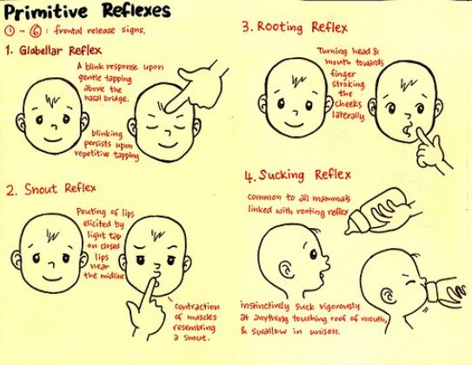
Complete the table in your A1. Physical development booklet, page seven, covering all the primitive reflexes.
You will need to revise each one!

Slide 13
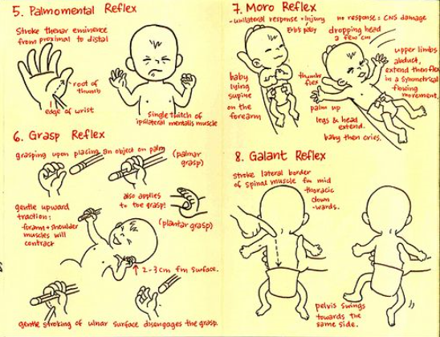
https://www.youtube.com/watch?v=PTz-iVI2mf4

Slide 14
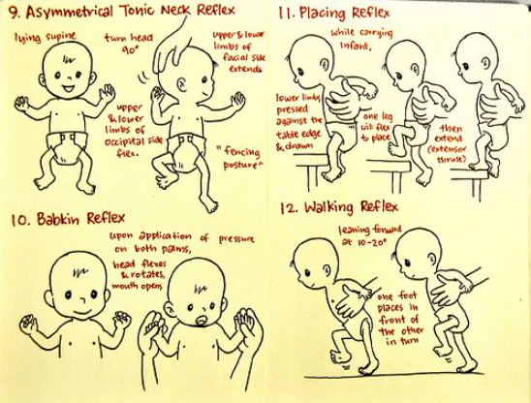
https://www.youtube.com/watch?v=dPyBzlD-854

Slide 15
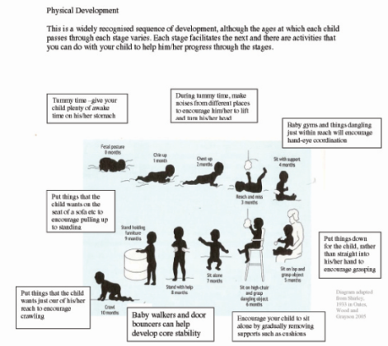
Gross motor skills
Gross motor skills are large movements, involving the bigger muscles, which require mobility and the coordination these require eg. Rolling over or reaching out.

Slide 16
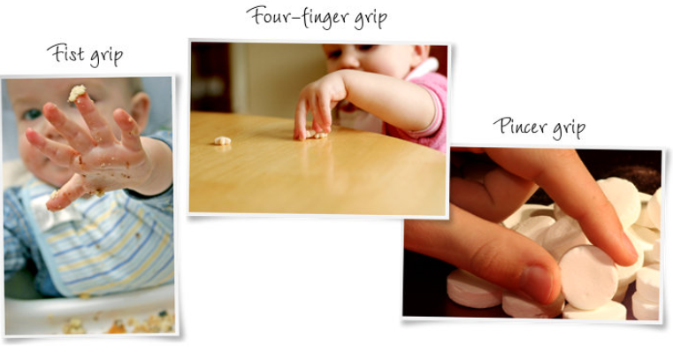
Fine motor skills; 0-2 years
Fine motor skills involve smaller precision movement, which requires dexterity and coordination. For example, picking up and holding a pencil, pincer movement.

Slide 17
Gross vs fine motor skills- Which are fine and which are gross? (predict before next slide!)
Cuts with scissors
Walks on tiptoes
Paints with a brush
Strings beads
Throws a ball
Inserts a puzzle piece
Balances on one foot
Walks up the stairs
Traces objects
Cuts fruit
Hopping
Zip up a coat
Pours liquid between containers
Rides a bike

Slide 18
Gross vs fine motor skills- Which are fine and which are gross? (bold are fine)
Cuts with scissors
Walks on tiptoes
Paints with a brush
Strings beads
Throws a ball
Inserts a puzzle piece
Balances on one foot
Walks up the stairs
Traces objects
Cuts fruit
Hopping
Zip up a coat
Pours liquid between containers
Rides a bike

Slide 19
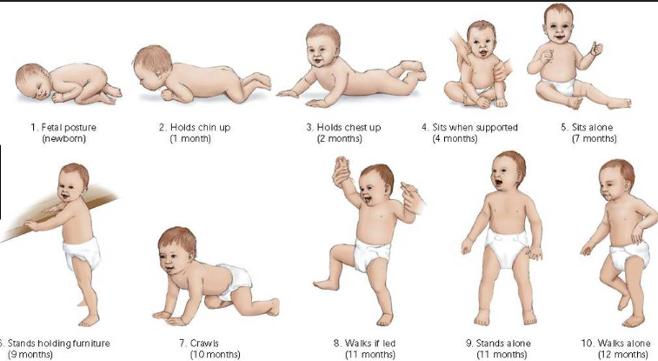
Mobility
What age do you think babies can do each of these?
Guess before you move onto next slide!
A lot of this is common sense, however, for the exam, you will be required to use correct terminologies to get the marks

Slide 20
Mobility
A lot of this is common sense, however, for the exam, you will be required to use correct terminologies to get the marks

Slide 21
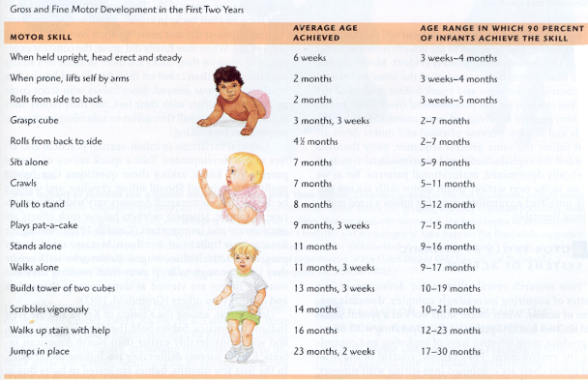

Slide 22
American, slightly different to UK
https://www.youtube.com/watch?v=bfxQH9YLNoQ

Slide 23
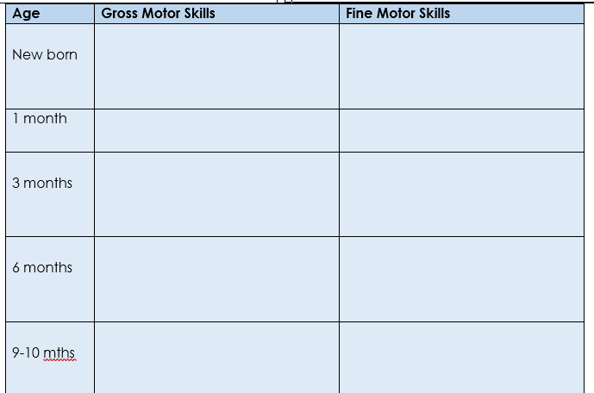
Revision task; Use BTEC Text book page 6 to complete.

